Slide 1
Android Application Development (I)
Practice – Project Breakdown (Custom UI)

Slide 2
Agenda
Self Introduction
Intellectual Property Rights
Project Introduction
Android Introduction
Get Started with Android
Requirement
Object-Oriented Analysis and Design
Scrum
Project Breakdown
Acceptance Test Criteria
Publish Application
Notes:
Object-oriented analysis and design (OOAD) is a software engineering approach that models a system as a group of interacting objects. Each object represents some entity of interest in the system being modeled, and is characterised by its class, its state (data elements), and its behavior. Various models can be created to show the static structure, dynamic behavior, and run-time deployment of these collaborating objects. There are a number of different notations for representing these models, such as the Unified Modeling Language (UML).
Object-oriented analysis (OOA) applies object-modeling techniques to analyze the functional requirements for a system. Object-oriented design (OOD) elaborates the analysis models to produce implementation specifications. OOA focuses on what the system does, OOD on how the system does it.
Ref: http://en.wikipedia.org/wiki/Object-oriented_analysis_and_design
IFRS - International Financial Reporting Standards
GAAP - Generally Accepted Accounting Principles

Slide 3
How Android Draw View
Drawing begins with the root node of the layout
Root
Root
View Group
View Group
View3
View 1
View2
View1
View2
View3
The tree is traversed in-order

Slide 4
How Android Draw View
Drawing the layout is a two pass process
A measure pass
At the end of the measure pass, every View has stored its measurements.
A layout pass.
During this pass each parent is responsible for positioning all of its children using the sizes computed in the measure pass.
Width & Height
Start_X & Start_Y

Slide 5
Custom Component Overview
Android offers a sophisticated and powerful componentized model for building your UI, based on the fundamental layout classes
View (Widget)
Button, TextView, EditText, ListView, etc
ViewGroup (Layouts)
LinearLayout, RelativeLayout, etc

Slide 6
Custom Component The Basic Approach
Extend an existing View class or subclass with your own class
Override some of the methods from the superclass, like the method starts with prefix ‘on’
Use the new extension class in place of the view upon which it was based

Slide 7
Custom Component Fully Customized Components
Extend from View to create new super component
Supply a constructor which can take attributes and parameters from the XML
Create the event listeners
Override onMesure and onDraw to show something on the component
Override other on… methods by demand

Slide 8
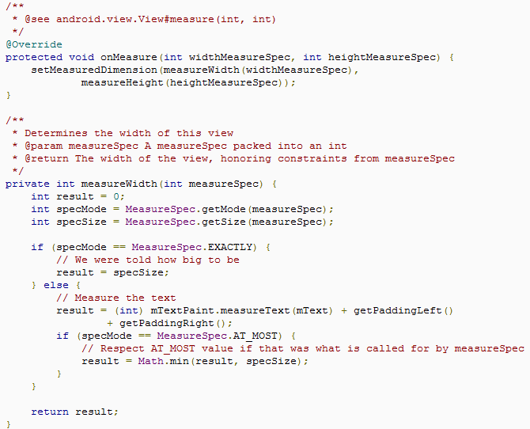
Custom Component Sample: Construct LabelView
Call that method to store the measured width and height of this view.
Note: fail to do that will trigger IllegalStateException
Determine the width of the view

Slide 9
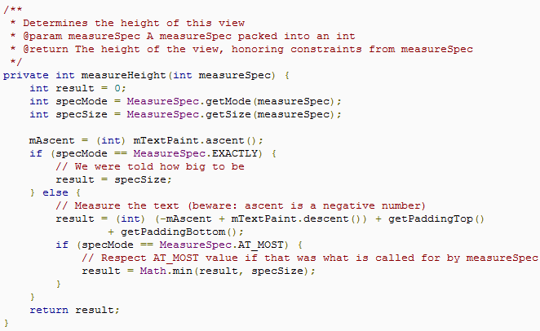
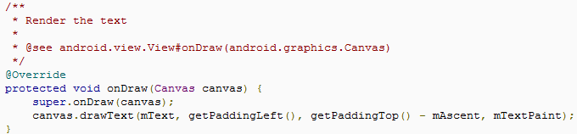
Custom Component Sample: Construct LabelView Cont.
ascent() return negative number
Determine the height of the view
Draw text according to start point X and Y

Slide 10
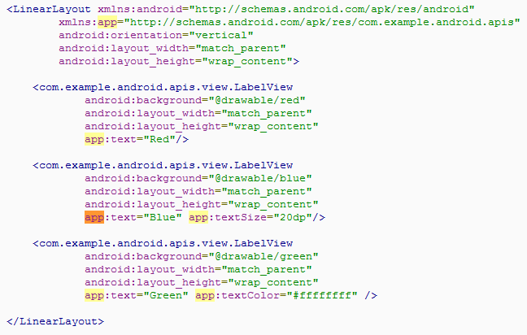
Custom Component Sample: Apply for LabelView
Apply for LabelView

Slide 11
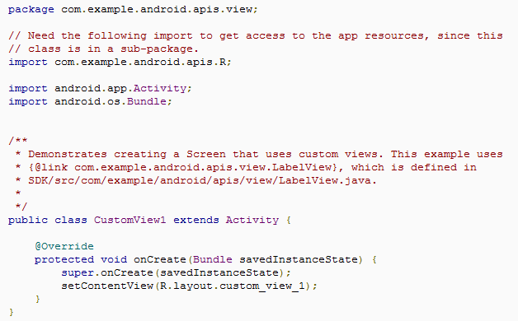
Custom Component Sample: Apply for LabelView Cont.
Draw with LabelView

Slide 12

App Widgets Overview
App Widgets are miniature application views that can be embedded in other applications (such as the Home screen) and receive periodic updates.
An application component that is able to hold other App Widgets is called an App Widget host.

Slide 13
App Widgets The Basics
To create an App Widget
AppWidgetProviderInfo object
Describes the metadata in XML for an App Widget, such as the App Widget's layout, update frequency, etc
AppWidgetProvider class implementation
Defines the basic methods that allow you to programmatically interface with the App Widget, based on broadcast events, just like updated, enabled, disabled and deleted.
View layout
Defines the initial layout for the App Widget, defined in XML.
An App Widget configuration Activity
This is an optional Activity that launches when the user adds your App Widget and allows him or her to modify App Widget settings at create-time.

Slide 14
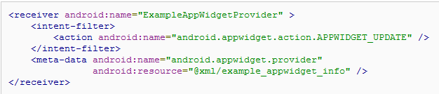
App Widgets In Practice
Declaring an App Widget in the Manifest
Specifies the AppWidgetProvider
used by the App Widget
specifies that the
AppWidgetProvider
Accepts the
ACTION_APPWIDGET_UPDATE broadcast
AppWidgetProviderInfo defined in XML

Slide 15
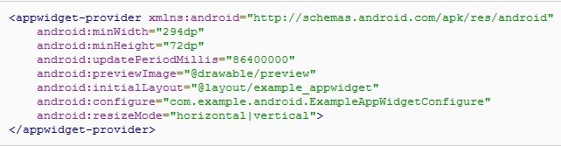
App Widgets In Practice
Adding the AppWidgetProviderInfo Metadata
Activity for the user to configure App Widget properties
Note: If the device is asleep when it is time for an update (as defined by updatePeriodMillis), then the device will wake up in order to perform the update.
How often the App Widget framework should request an update
Instead, you perform the update with AlarmManager, which only delivery the alarm when the device is awake

Slide 16
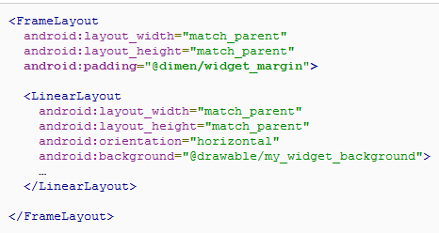
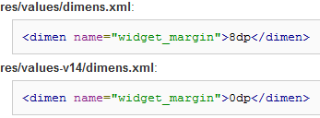
App Widgets In Practice
Creating the App Widget Layout
Widgets should not generally extend to screen edges, so we need to add some margins
pre-Android 4.0 custom margins
provide no extra padding for Android 4.0 widgets

Slide 17
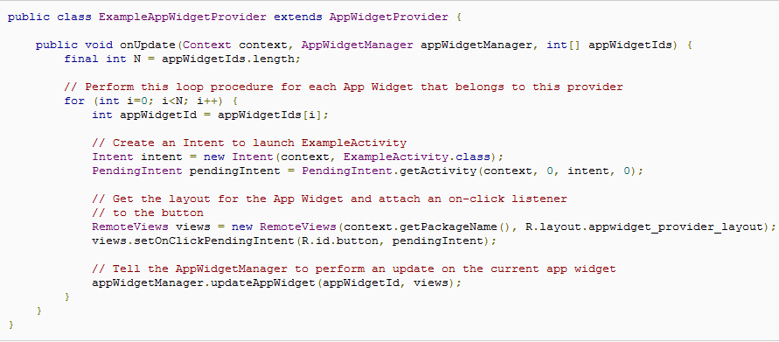
App Widgets In Practice
Using the AppWidgetProvider Class
ANR
? Think about what will happen if app widget setup process can take several seconds
Create intent to launch activity
Get layout
starting a Service in the onUpdate() method
Update app widget
Thread - safe

Slide 18
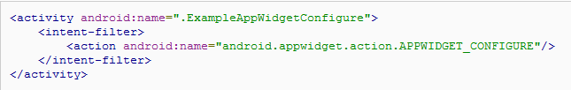
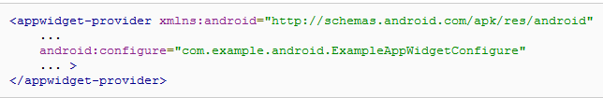
App Widgets In Practice
Creating an App Widget Configuration Activity
Claim this activity in AndroidManifest.xml
Apply this Config activity in the XML AppWidgetProviderInfo

Slide 19
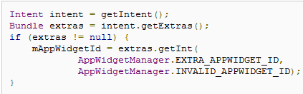


App Widgets In Practice
Updating the App Widget from the configuration Activity
Get the App Widget ID from the Intent that launched the Activity
Perform your App Widget configuration
When the configuration is complete, get an instance of the AppWidgetManager by calling getInstance(Context)
Update the App Widget with a RemoteViews layout by calling updateAppWidget(int, RemoteViews):
Create the return Intent, set it with the Activity result, and finish the Activity

Slide 20
Project Breakdown (SoundRecorder) Requirement - Audio Spectrum & Progress Bar View
Drawing audio spectrum view while recording according to the amplitude got from MediaRecorder
Drawing progress bar view while playing according to playing progress, which can adapt to different screen resolution

Slide 21
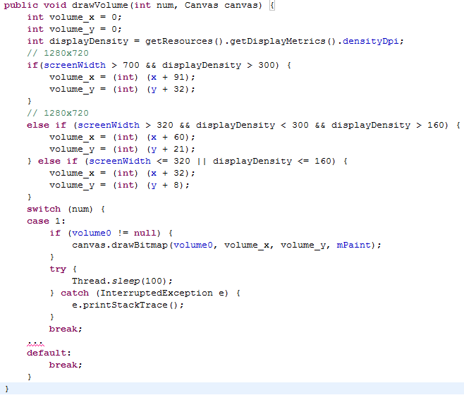
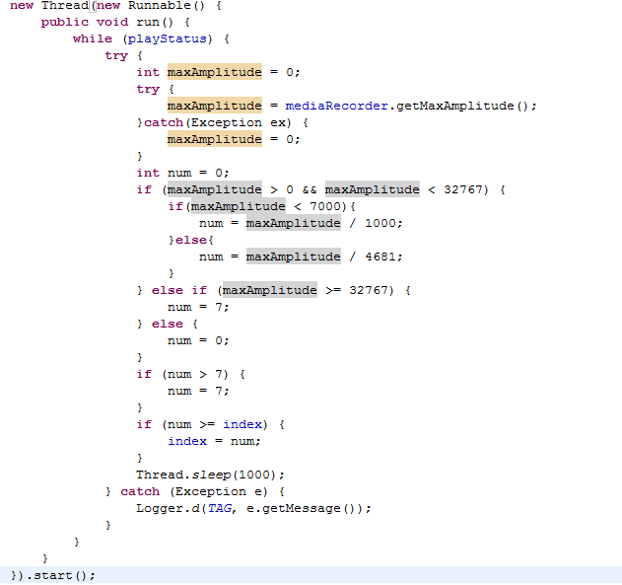

Project Breakdown (SoundRecorder) Hints – Audio Spectrum View (getMaxAmplitude & Canvas)
Audio spectrum view is composed of 7 Bitmaps elements [Ref]
Returns the maximum absolute amplitude that was sampled
The Canvas class holds the "draw" calls.

Slide 22



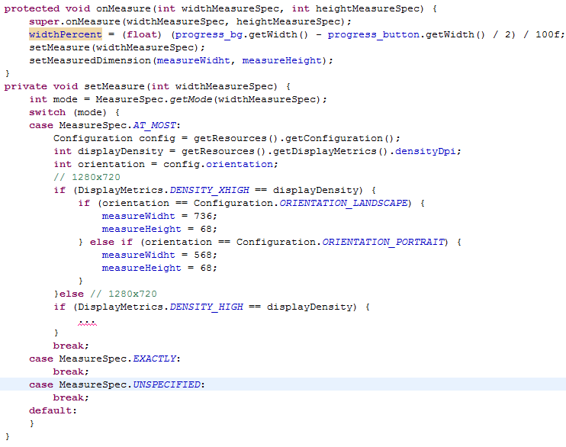
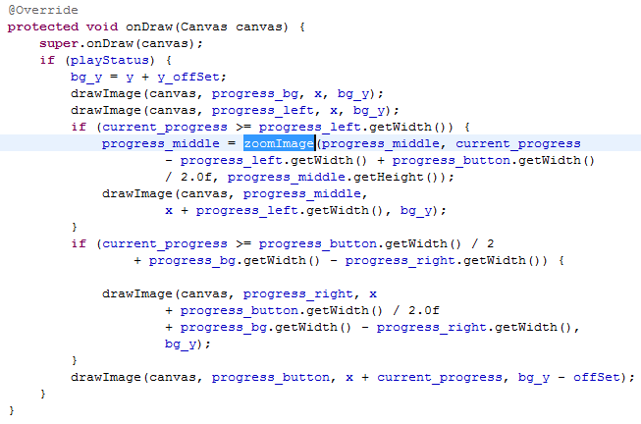

Project Breakdown (SoundRecorder) Hints – Progress Bar View (setMeasuredDimension & Canvas)
Progress bar view is composed of 4 Bitmaps elements [Ref]
(circle left middle right )
With current progress to draw progress bar
When overriding method onMeasure (int widthMeasureSpec, int heightMeasureSpec), you must call setMeasuredDimension(int, int) to store the measured width and height of this view.
Failure to do so will trigger an IllegalStateException, thrown by measure(int, int)
Convert is called while refreshHandler is handling msg about msg_update_time

